Slide 1


Predicting Vehicle Insurance Fraud claims
Gourav Bajaj (301148324)

Slide 2
Executive Summary
Assumptions and Dependencies
Exploratory Data Analysis (EDA)
Model Comparison
Model Recommendation
Model Validation and Future Work
Agenda

Slide 3
Executive Summary
This Analysis is for the Vice President of a leading Insurance company.
Purpose and Process: -
To determine key factors and build a model that are most closely indicative of a claim application being fraud.
Various predictive models were built and compared in order to determine the best model.
Logistic regression model determined as the best model on the basis of model accuracy.
Logistic regression model should be used for predicting fraudulent claims.
Further investigation, strict actions and fraud control strategies should be implemented to prevent fraud in future.

Slide 4
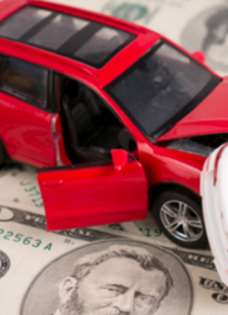
About Vehicle Insurance
Insurance for cars, trucks, motorcycles and other road vehicles.
Provides financial protection from risks.
51.1% share of total annual premiums received.
The industry is worth $316 billion.

Slide 5
Problem Statement
The frequency of insurance fraud incidents have increased.
The fraudulent activities have resulted in high costs.
Insurance companies facing pricing difficulties.

Slide 6
Vehicle Insurance fraud claims dataset
Variables | Description
Month | The 3 letter abbreviations for the months of the year in which accident occurred.
WeekOfMonth | The week in the month the accident occurred.
DayOfWeek | The day of week in which accident occurred.
Make | The list of 19 car manufacturer.
AccidentArea | The area in which accident occurred (Urban/Rural)
DayOfWeekClaimed | The day of week in which the application for claim made.
MonthClaimed | The month of year in which the application for claim made.
WeekOfMonthClaimed | The week of month in which the application for claim made.
Sex | The gender of the policy holder.
MaritalStatus | The Marital status of the policy holder.
Age | The age of the policy holder.
Fault | The person who was at fault (Policy holder/ Third party).
PolicyType | The type of insurance policy and the category of vehicle insured.
VehicleCategory | The category of vehicle insured.
VehiclePrice | The ranges for price of vehicles.
FraudFound_P | The claim application is fraud or not (Binary).
Variables | Description
PolicyNumber | The policy number
RepNumber | This column contains integers from 1 to 16 [Assumed as employee ID)
Deductible | The amount to be deducted for the claim.
DriverRating | The driver ratings on the basis of driving skills.
Days_Policy_Accident | The number of days between when the policy was purchased, and the accident occurred.
Days_Policy_Claim | The number of days between when the policy was purchased, and the claim filed.
PastNumberOfClaims | The past number of claims filed by policy holder.
AgeOfVehicle | It states how old is the Vehicle at the time of accident.
AgeOfPolicyHolder | The age of policy holder bucketed into the ranges.
PoliceReportFiled | Indicates whether a police report was filed (Binary).
WitnessPresent | Indicated whether a witness was present at the time of accident (Binary).
AgentType | The agent handling the claim is external or internal.
NumberOfSuppliments | The number of supplements to the claims.
AddressChange_Claim | The difference in years from the address change application to the claim filled
NumberOfCars | The number of cars covered under the insurance policy.
Year | Year in which the accident occurred.
BasePolicy | Type of insurance coverage.

Slide 7





Analysis Path
Data Exploration & Preparation
Modelling
Analysis Plan
Best Model
Logistic Regression
Recommendations
& Conclusion

Slide 8
Assumptions and Dependencies
The personal information provided is legitimate.
The testimony provided by the witness is true.
The data is stationary through the observation window.
The data is the correct representation of the time frame.
The person driving the vehicle may not be the policyholder.

Slide 9
Key Observations from Exploratory Data Analysis
There were no missing values in the data.
Replaced zeros in columns Age, DayOfWeekClaimed and MonthClaimed.
Some values in Age column doesn’t belong to their respective buckets in AgeOfPolicyHolder column.
Make column was bucketed into a new column.
Dataset suffered from the class imbalance problem; SMOTE function was used to upsample the minority class.

Slide 10
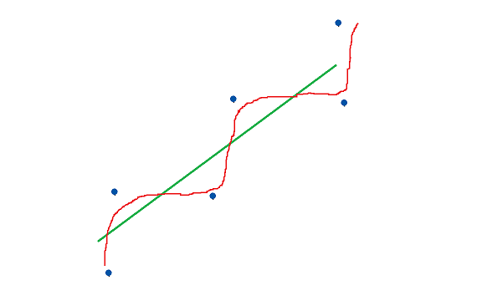
What is Model Overfitting ?
Green line represents true relationship.
Red line represents overfitted relationship

Slide 11
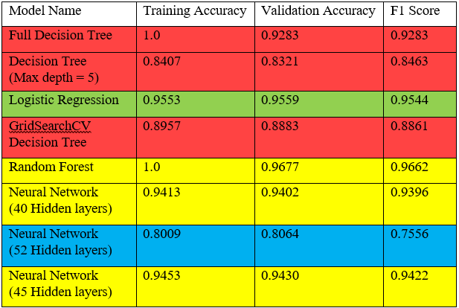
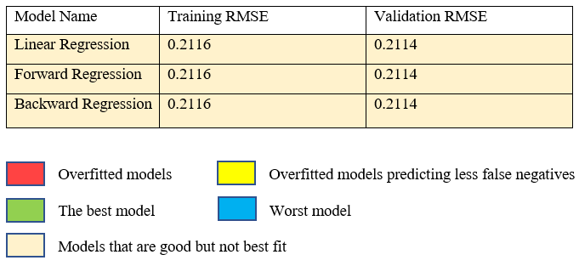
Model Comparison

Slide 12
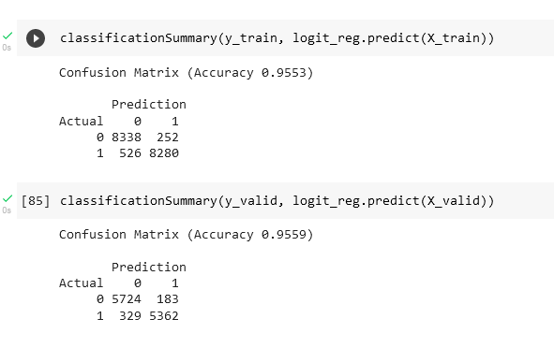
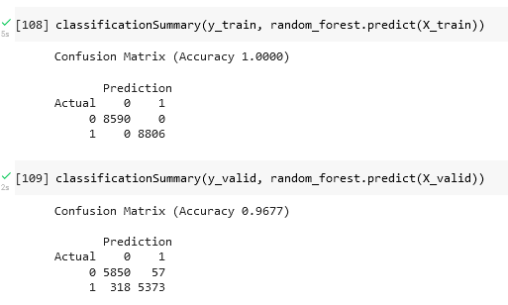
Model Recommendation
Logistic Regression was predicted to be the best model.
Logistic Regression Classification Summary
Random Forest Classification Summary

Slide 13
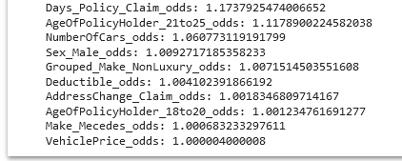
Model Recommendation
The chances of a claim being fraud is highly dependent on: -
Days_Policy_Claim
AgeOfPolicyHolder_21 to 25
NumberOfCars
Sex_Male
Grouped_Make_Non-Luxury
Further investigation
Strict actions
Fraud control strategies.

Slide 14
Model Validation Plan
ROC or AUC, False Negatives and True Positive value analysis will be performed every month.
The following actions should be taken of 3-4% drift from baseline observed.
Retune the model
Use Principal Component Analysis (PCA)
Add pertinent dimensions

Slide 15
Future Work
Regularization should be used quarterly.
Some adjustments may be needed in future in variable “SEX”.

Slide 16
THANK YOU
Q & A

